Slide 1
Impact of Noncoding Structural Variation on Autism
Danny Antaki
Sebat Lab
BMS Recruitment 2/24/2018

Slide 2
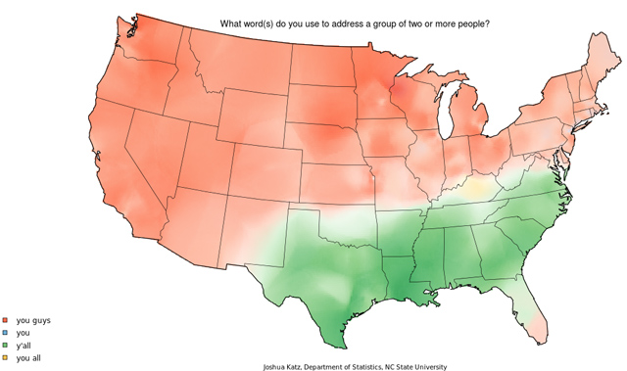



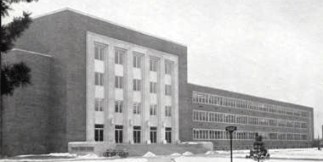


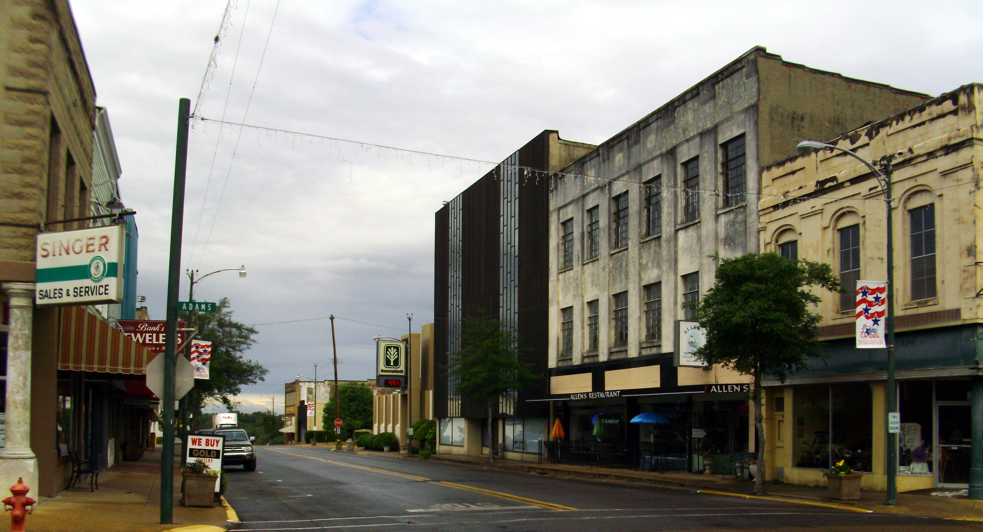


Jonathan Sebat
Validating de novo CNVs with Microarrays
Bruce Torbett
HIV-1 GAG evolution
Dong-Er Zhang
Metanalysis of gene expression in AML cell lines

Slide 3
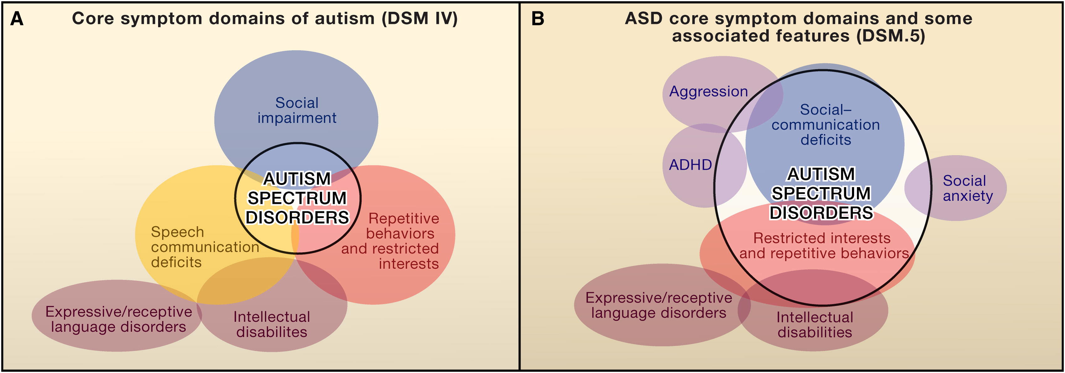
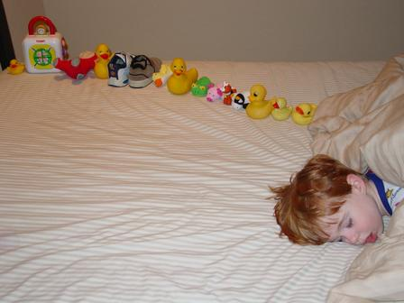
Autism is a social deficit disorder
Developmental disorder
Affects males more than females (4:1)
Wide range of phenotype
High functioning to Intellectual Disability
~1% prevalence
“Increases” due to awareness and diagnostics
Lord C. Cell. 2011 Sep 30;147(1):24-5.
Wikipedia Commons

Slide 4
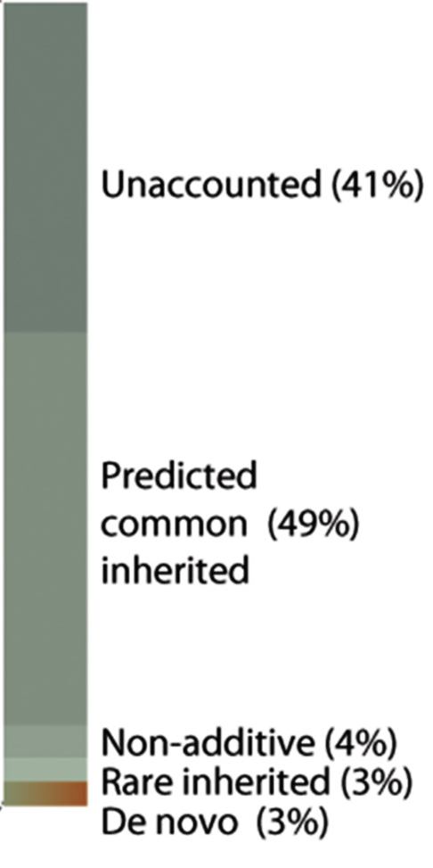
Genetic evidence for Autism
64-91% heritability (MZ twins)
Genetic contributions:
2 GWAS hits (common variants)
3 % De Novo (new in child) Variants
Copy number variations
Loss of Function or Missense Mutations
3% Rare Inherited
94% Missing Heritability
Damaging noncoding variants?
Ramaswami G, Geschwind DH. Handbook of clinical neurology. 2018
Notes:
Standard progression of genetic association, but with little success until recently.

Slide 5
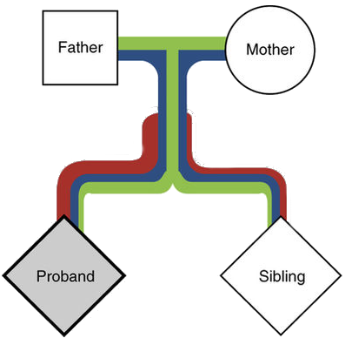
Searching for Noncoding Structural Variants (SV)
SV have greater effect than SNPs
First genetic associations were structural
Transmission Disequilibrium Test (TDT)
Binomial test for deviation from the expected transmission rate (50%)
Benefits:
Additive model by grouping genes (increases power)
Controls for ancestry and linkage
Caveats:
Effective on rare variants (MAF < 1%)
Genotyping error confounds transmission rate
The affected child (proband) inherits more damaging rare mutations (red), than the control sibling.
Adapted from Krumm et al. Nat Gen 2015

Slide 6
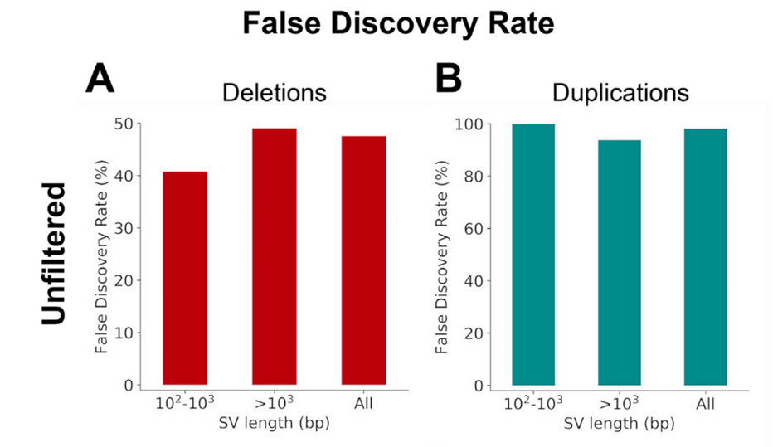


Raw SVs have high False Discovery Rates
Multiple algorithms are needed to capture the wide range of SV
False positive SVs in offspring appear as de novo
How do we filter SV without being too stringent?
Machine learning
WGS SVs were validated using Illumina 2.5M arrays (N=57) with SVToolkit.

Slide 7
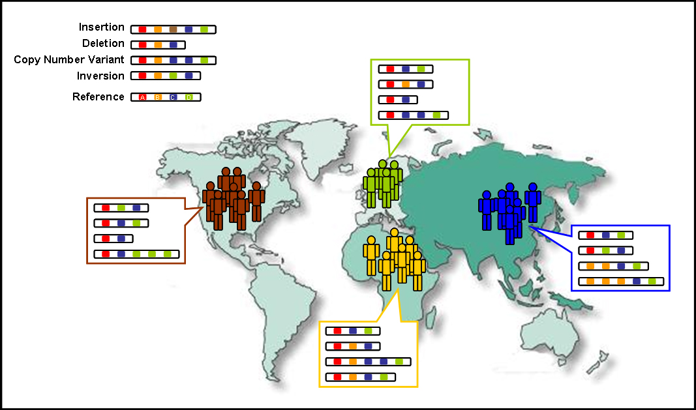
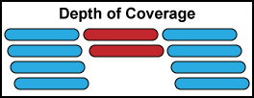
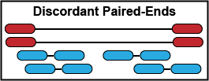
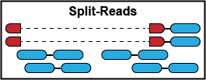
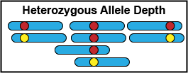
Constructing the model
Training Set: 1000 Genomes Project ~1-4% FDR
Diverse set of common SV
27 high coverage whole genomes
2,494 low coverage genomes
Sudmant et al. Nature 2015
Features:
Next generation sequencing data

Slide 8
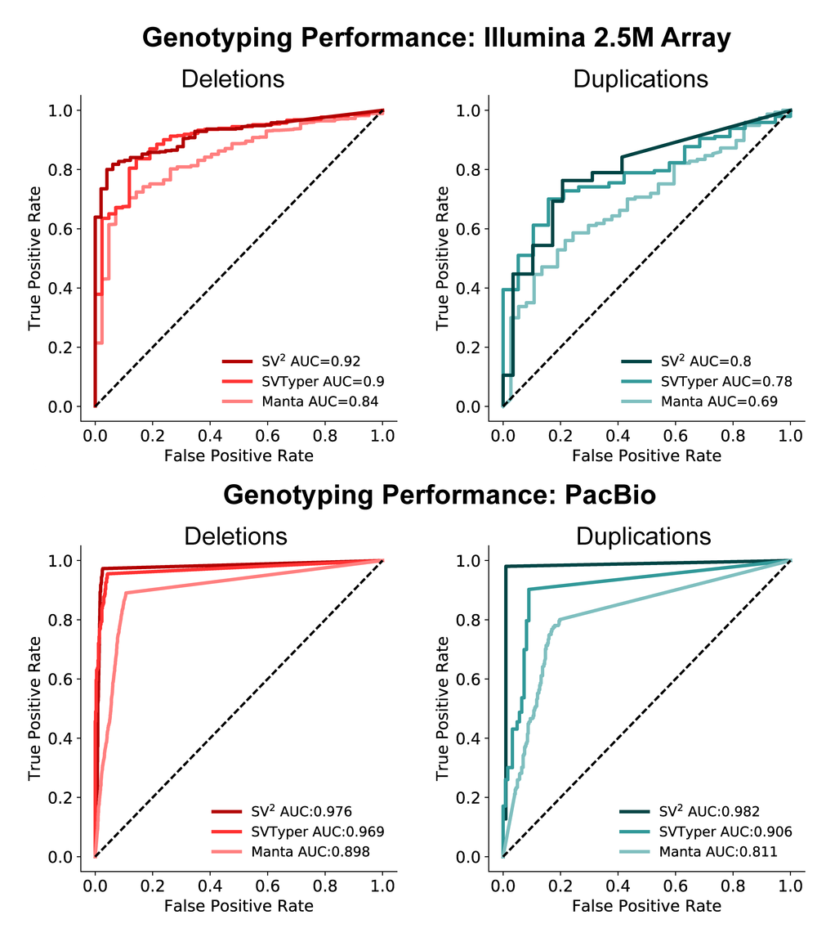
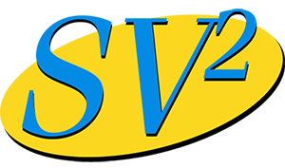
SV² outperforms probabilistic models
Orthogonal validation of genotypes
Microarrays (N=57)
PacBio Long Reads (N=9)
SV² (Support-Vector Structural-Variant genotyper) is freely available
https://github.com/dantaki/SV2
Antaki D. et al. Bioinformatics 2017

Slide 9


SV discovery in 3,169 whole genomes
Interrogated the role of noncoding (cis-regulatory) SVs in 829 families
880 affected offspring
630 control siblings
Two Cohorts
REACH: local sourced ASD patients (Rady Children’s Hospital)
Simons Simplex Consortium: screened negative for de novo LoF mutation or large SV
Sought to characterize de novo and inherited SVs.
Do rare inherited cis-regulatory SV contribute risk to autism?
Collaborative effort
William Brandler Madhu Gujral

Slide 10
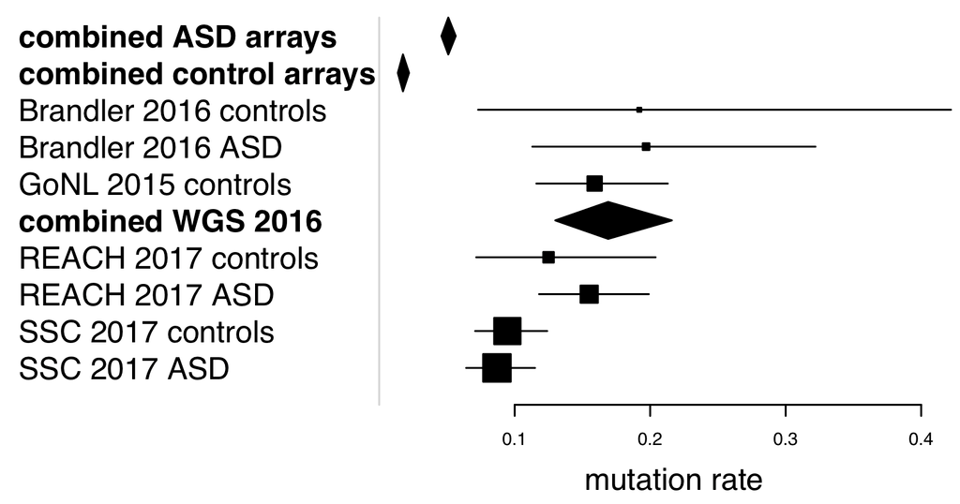
Equal rates of de novo SVs in cases and controls
15-20% of fertilizations have a de novo SV
Affected were enriched for gene disrupting de novo variants (P=9.2x10⁻⁵)
Brandler WM, Antaki D, Gujral M. et al. AJHG 2016

Slide 11
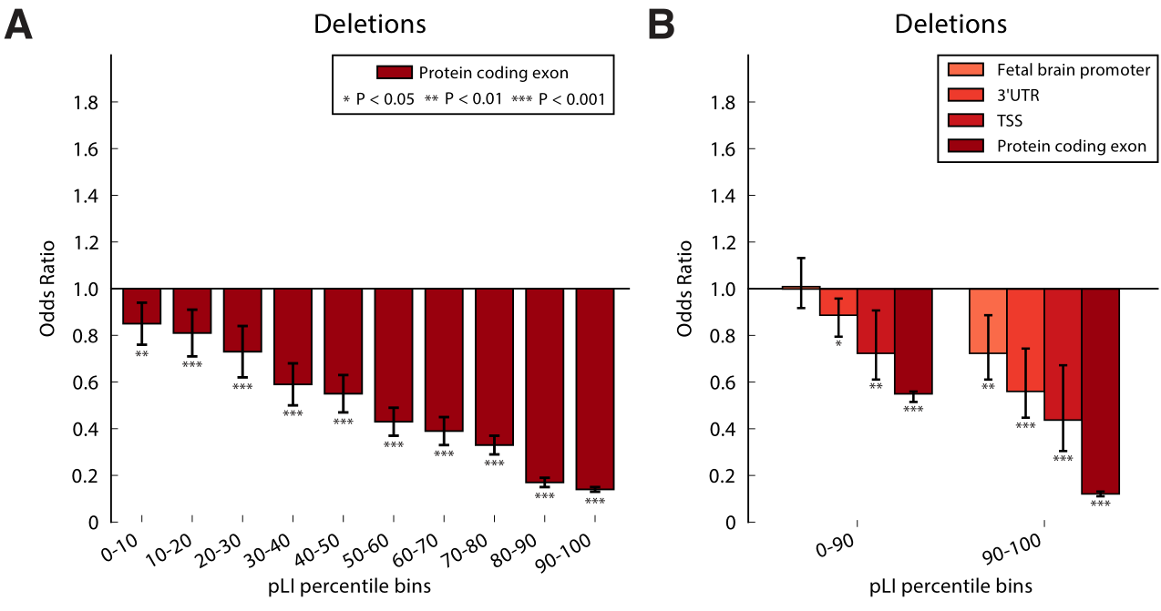
Intolerant functional elements are rarely deleted
Genes with strong negative selection
Probability Function Intolerance (pLI)
ExAC whole exomes
Permuted variants using a model that correlated breakpoints to genomic features (Prateek Tandon)

Slide 12
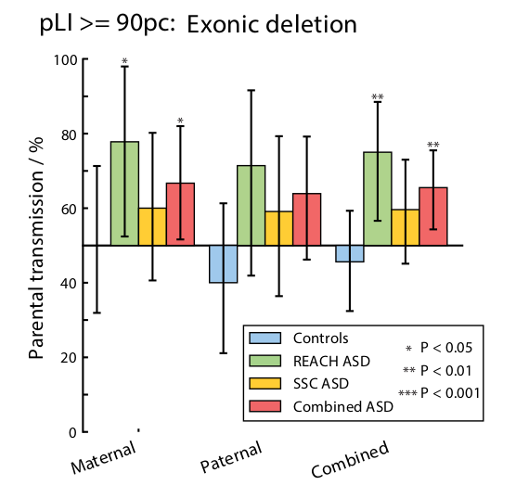
Protein coding deletions are over-transmitted to cases
Restrict analysis to private variants
Singletons in parents
Transmission bias for intolerant genes
Affected: 65.1% (54/83)
Control: 45.6% (26/57)
Confirmation of previous findings

Slide 13
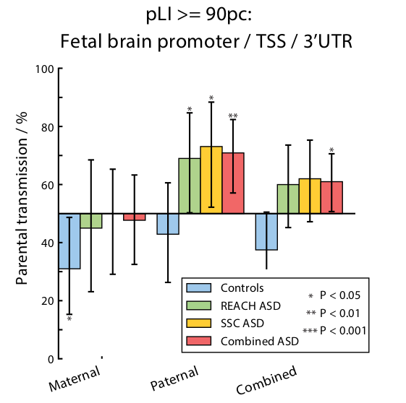
Fathers over-transmit cis-regulatory SVs to cases
Restricted to private variants (N=99)
Fetal brain promoters mapped to the nearest gene (RoadmapEpigenomics)
Fathers, but not mothers over-transmitted cis-regulatory SVs (70.9% vs. 47.7%)

Slide 14
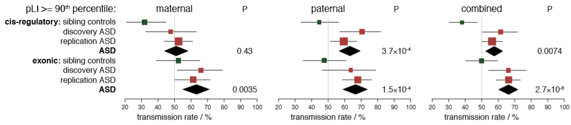
Cis-regulatory SV association replicated in larger cohorts
Collaboration with Stephen Scherer (MSSNG) added 3,769 whole genomes
SSC phase 2 released (N=2,336)
9,274 total individuals
1,979 cases
2600 families

Slide 15
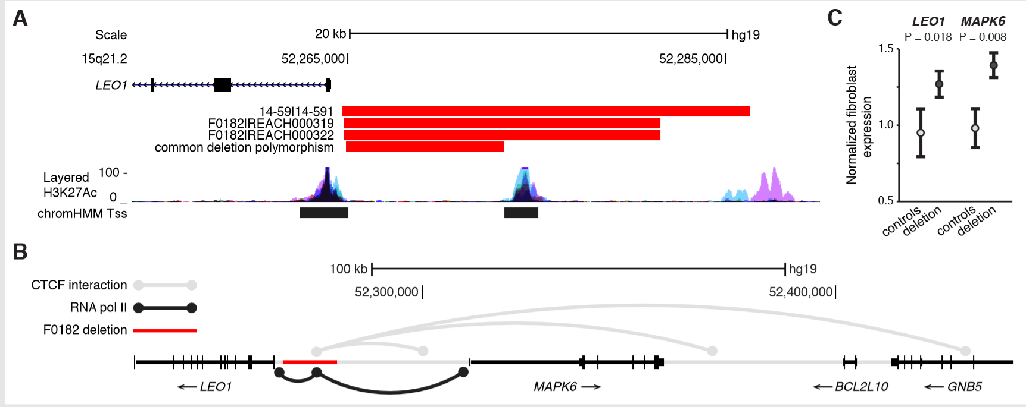
Recurrent cis-regulatory SV in LEO1
ChIA-PET data suggests the deleted region regulates LEO1 and MAPK6
Patient fibroblasts had higher expression of LEO1 and MAPK6

Slide 16
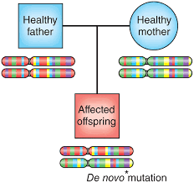



Proposed Genetic Models of Autism
Dominant de novo
~5% of cases
Inherited: Maternal Loss of Function
1.2% of cases
Inherited: Paternal cis-regulatory SV
0.77% of cases
Findings suggest a bilineal model with a strong parent of origin effect
However, a substantial portion of heritability remains unexplained.
Other models include:
Recessive / Compound Heterozygous
Mosaic

Slide 17
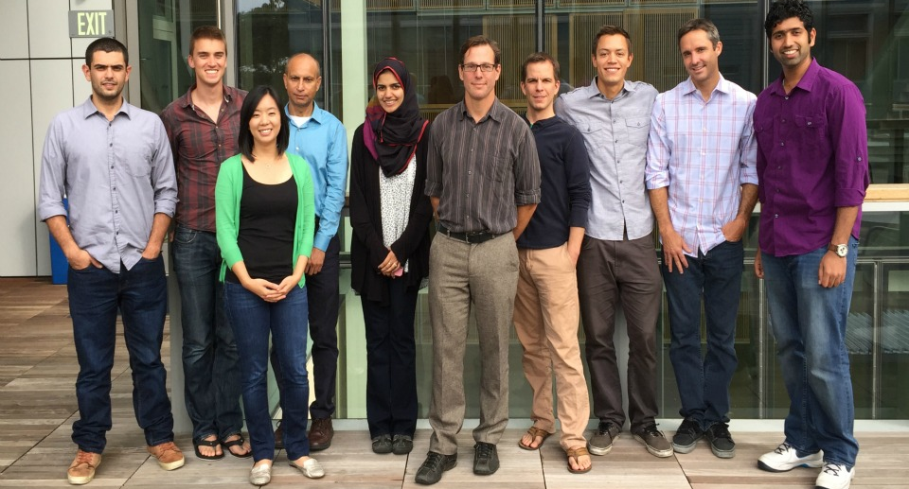
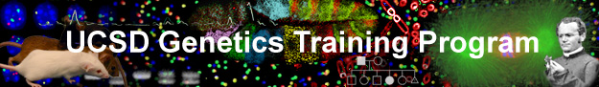
Acknowledgements
Sebat Lab
William Brandler
Madhu Gujral
Prateek Tandon
Oanh Hong
Morgan Kleiber
Tim Chapman
Michelle Maile
Stephen Scherer (MSSNG)
Rady Children’s Hospital
REACH project
Human Longevity Institute
Simons Simplex Project
1000 Genomes Project
San Diego Supercomputer Center
Thesis Committee
Jonathan Sebat: chair
Joseph Gleeson
Albert La Spada
Alysson Muotri
Nicholas Schork
Funding:
NIH predoctoral training grant T32 GM008666 (UCSD Genetics Training Program)
Amazon Web Services Research Grant
Sebat Lab funding:
NIH: MH076431, MH113715
Beyster Family Foundation

